Slide 1
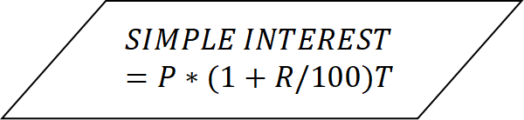
START
INPUT THE VALUE OF PRINCIPAL(P)
INPUT THE VALUE FOR RATE(R)
PRINT Simple Interest
$$SIMPLE INTEREST =P∗(1+R/100)T$$
INPUT THE VALUE OF TIME(T)
STOP
FLOWCHART TO CALCULATE SIMPLE INTEREST

Slide 2
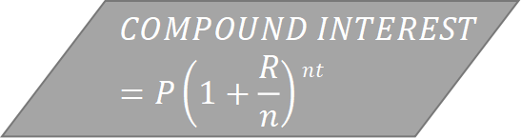
INPUT PRINCIPAL(P)
INPUT TIME(T)
START
$$COMPOUND INTEREST=P\left(1+\frac{R}{n}\right)nt$$
INPUT THE NUMBER OF TIMES PER YEAR(n)
INPUT RATE(R)
PRINT Compound Interest
STOP
FLOWCHART TO COMPUTE THE COMPOUND INTERESTS

Slide 3
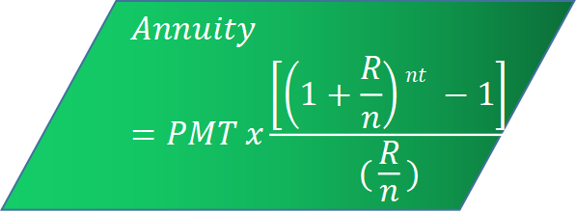
Input Rate(R)
START
Input Principal(P)
$$Annuity =PMT x\frac{\left[\left(1+\frac{R}{n}\right)nt −1\right]}{(\frac{R}{n})}$$
Input the number of times in a year(n)
Input Time(t)
FLOWCHART TO CALCULATE THE ANNUITY
PRINT annuity value
STOP

